Slide 1
Eco-Rent Hub
IXD802
FUNDAMENTAL TOOLS OF USER INTERFACE

Slide 2

Problem Statement
Many university students residing in dormitories or hostels face challenges in acquiring and utilizing essential electrical appliances due to restrictions, limited space, and concerns about excessive electricity usage. The absence of a convenient and sustainable solution hinders students from accessing necessary appliances for a comfortable living environment within the bounds of university rules. This project aims to address these challenges by developing a rechargeable appliance rental platform, facilitating easy access to essential electrical items while adhering to university regulations and promoting eco-friendly practices among students.

Slide 3
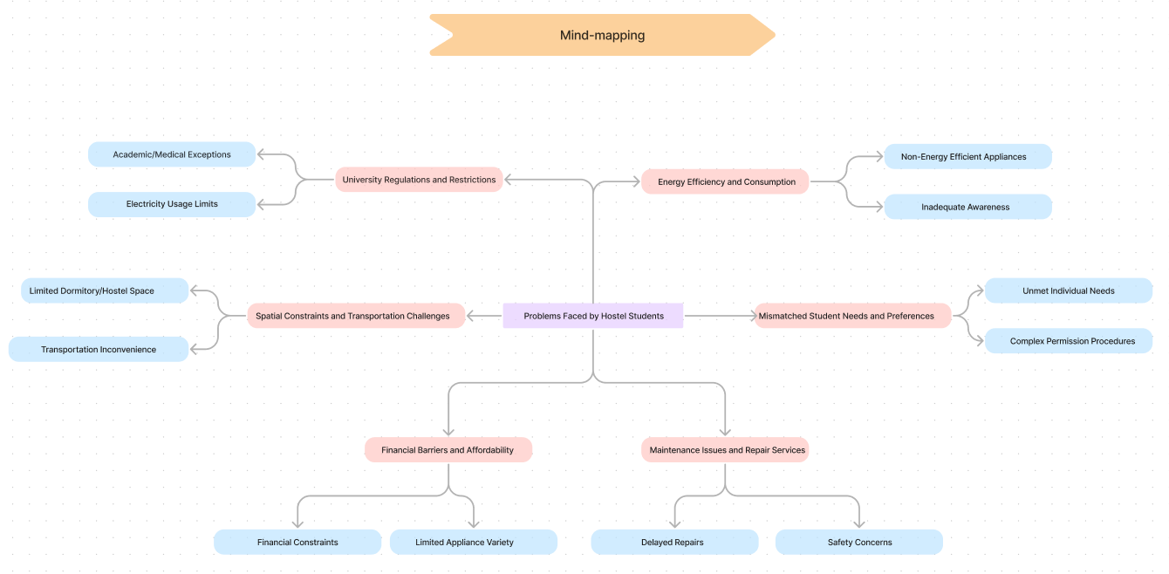
Mind-mapping

Slide 4
Case Studies
Case Study 1: University Regulations and Restrictions
Problem: Limited Power Allocation
“The university strictly enforces a policy allowing students to bring only one set of belongings to their dormitories. This limitation extends to electrical appliances due to concerns about excessive power usage.”
Issues:
Students face challenges in deciding which electrical appliances to bring, often prioritizing only essential items.
The strict power limits lead to frequent power outages in dormitories, affecting students' daily routines and study schedules.
Solution:
Implement a rechargeable appliance rental platform:
Students can rent essential appliances on a need-basis, ensuring access without violating university rules.
The platform educates students on energy-efficient practices, minimizing the risk of exceeding power limits.

Slide 5
Case Studies
Case Study 2: Financial Barriers and Affordability
Problem: Financial Constraints and Limited Appliance Variety
“A university provides basic electrical appliances in dormitories, but students face financial constraints and limited options for additional appliances.”
Issues:
Many students cannot afford to purchase additional appliances needed for a comfortable living environment.
The lack of variety in provided appliances does not cater to individual needs, leading to dissatisfaction.
Solution:
Introduce a cost-effective rechargeable appliance rental service:
Students can rent appliances at affordable rates, eliminating the financial burden of purchasing.
The platform offers a diverse range of appliances, ensuring students have access to items that suit their individual preferences and needs.

Slide 6
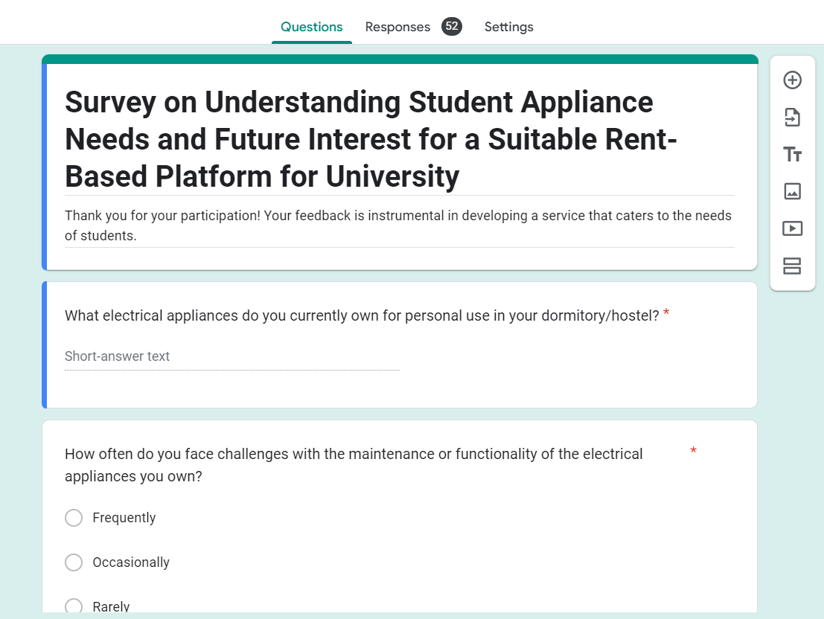
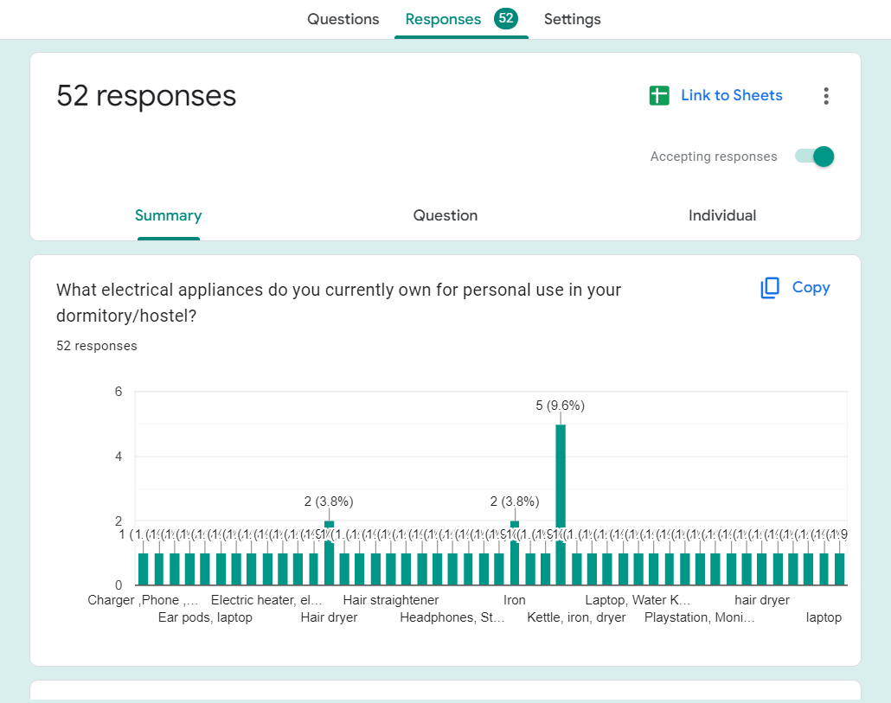
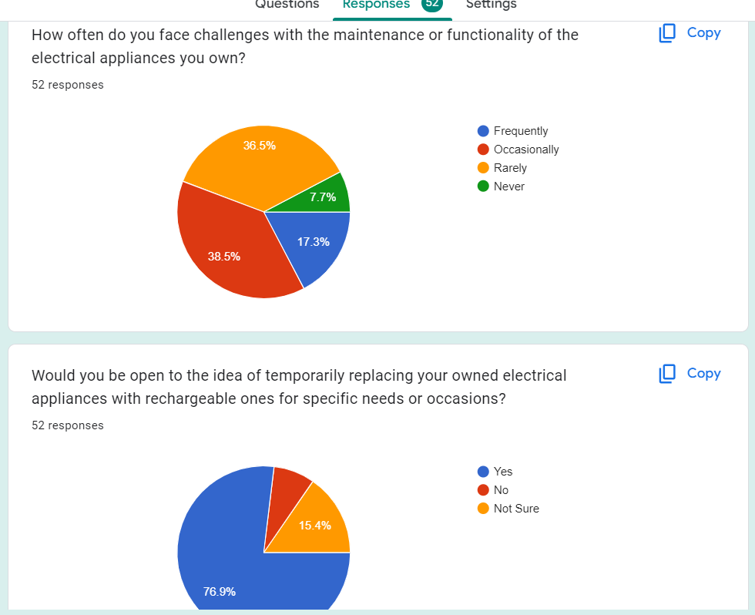
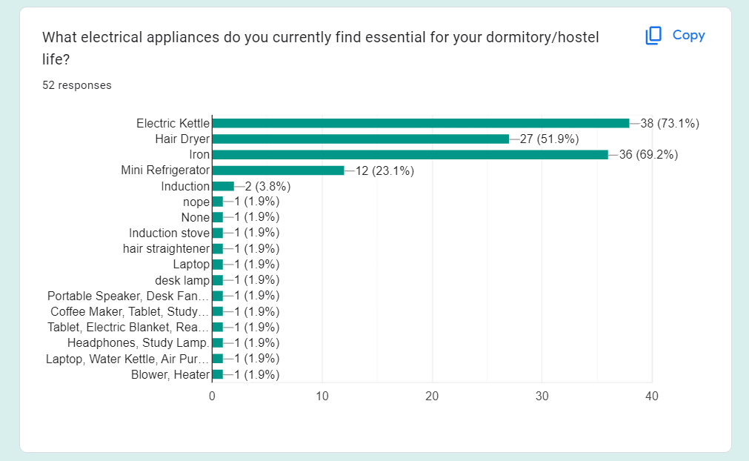
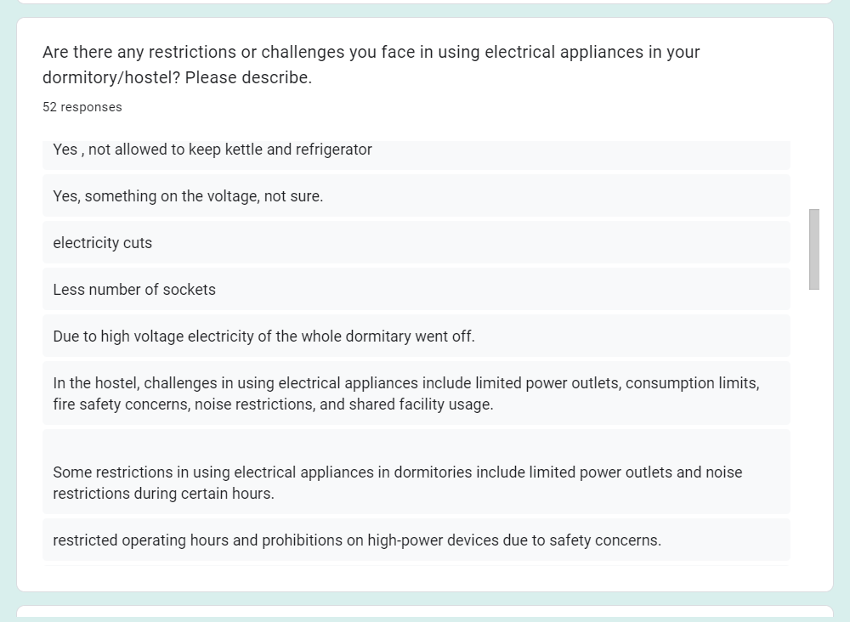
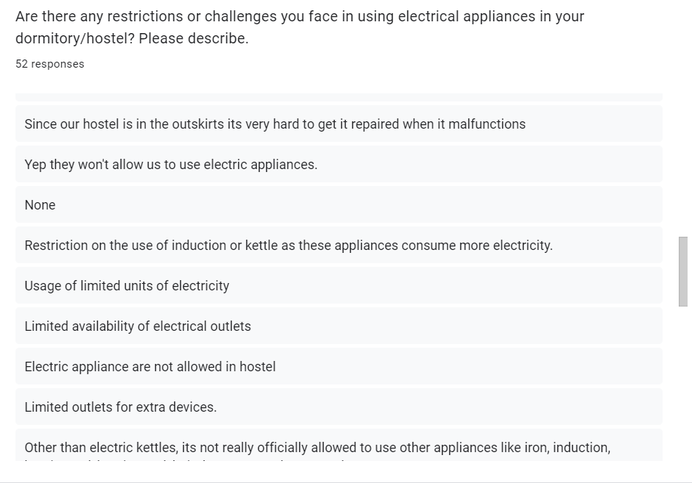
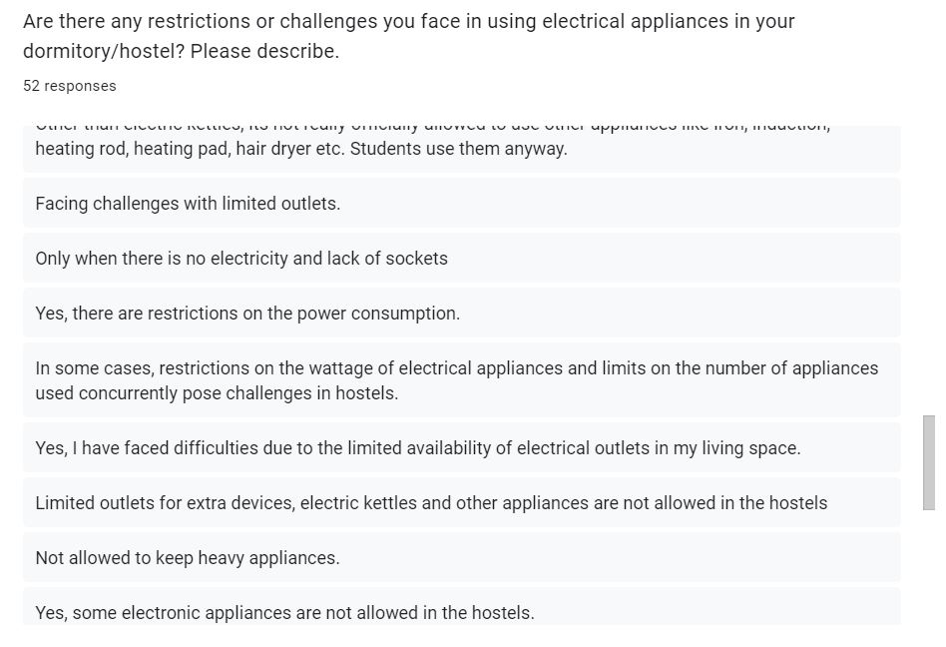
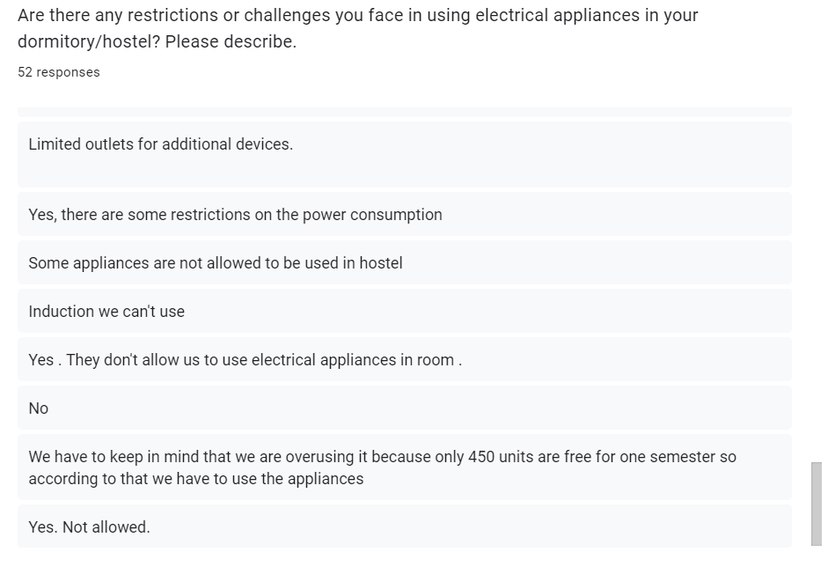
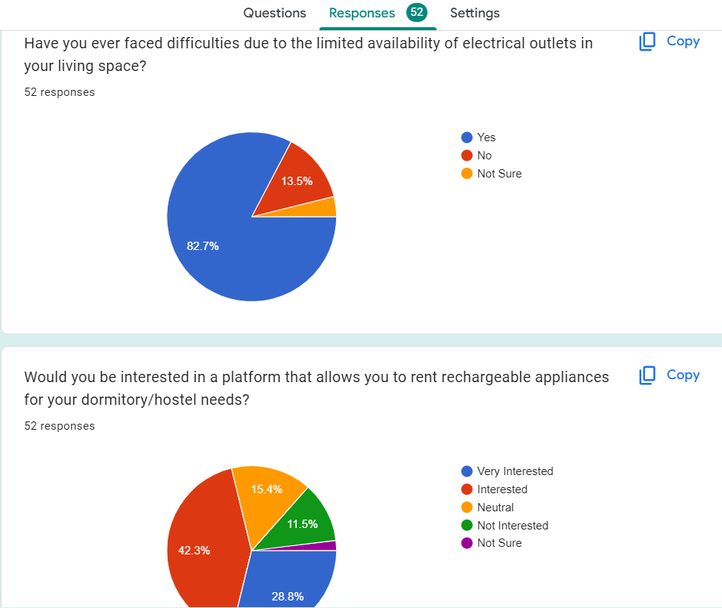
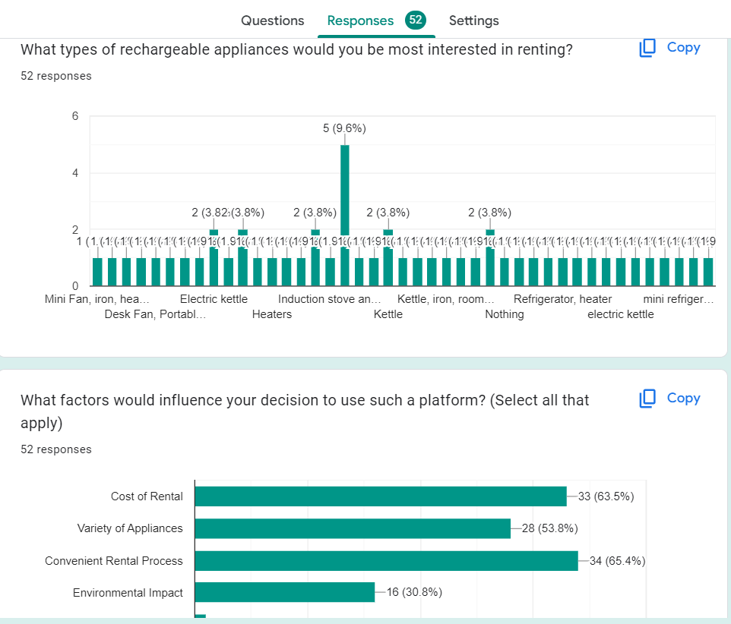
Surveys

Slide 7
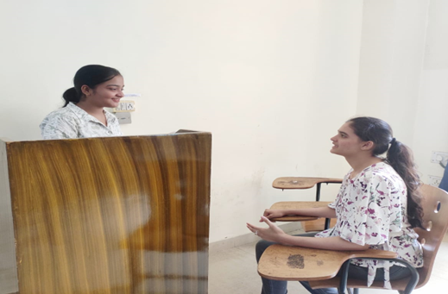
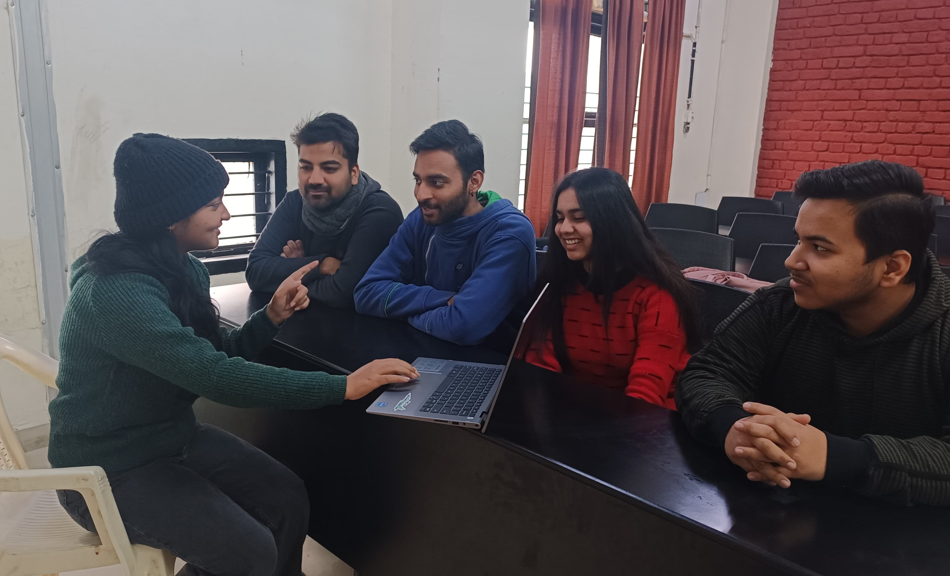
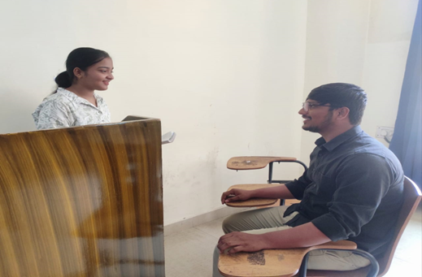
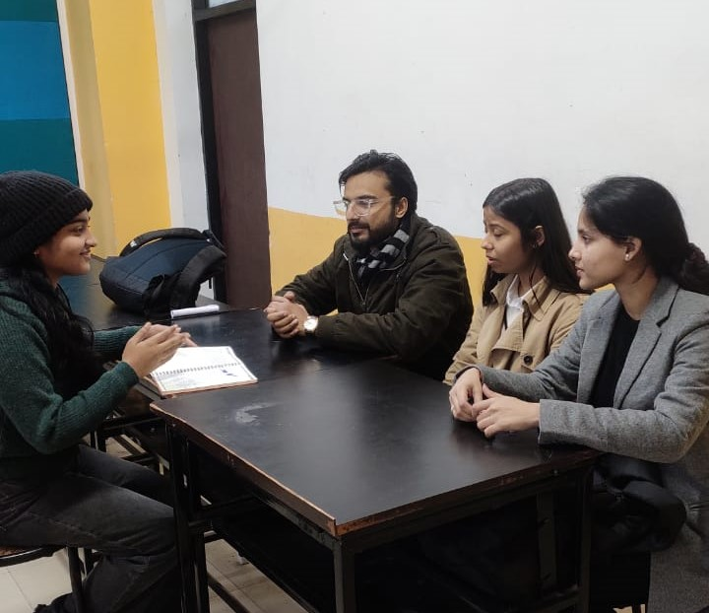
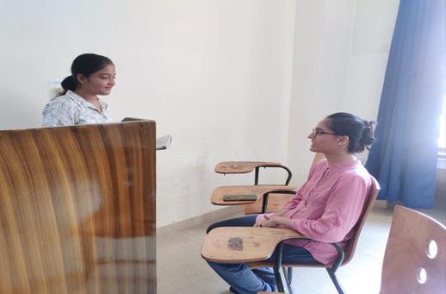
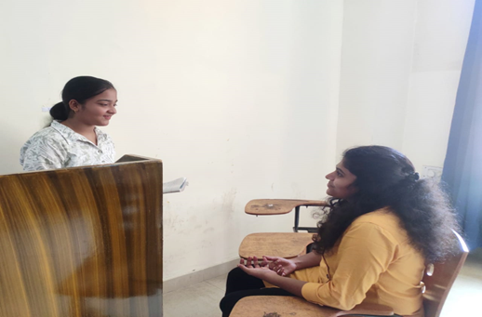
Interviews

Slide 8
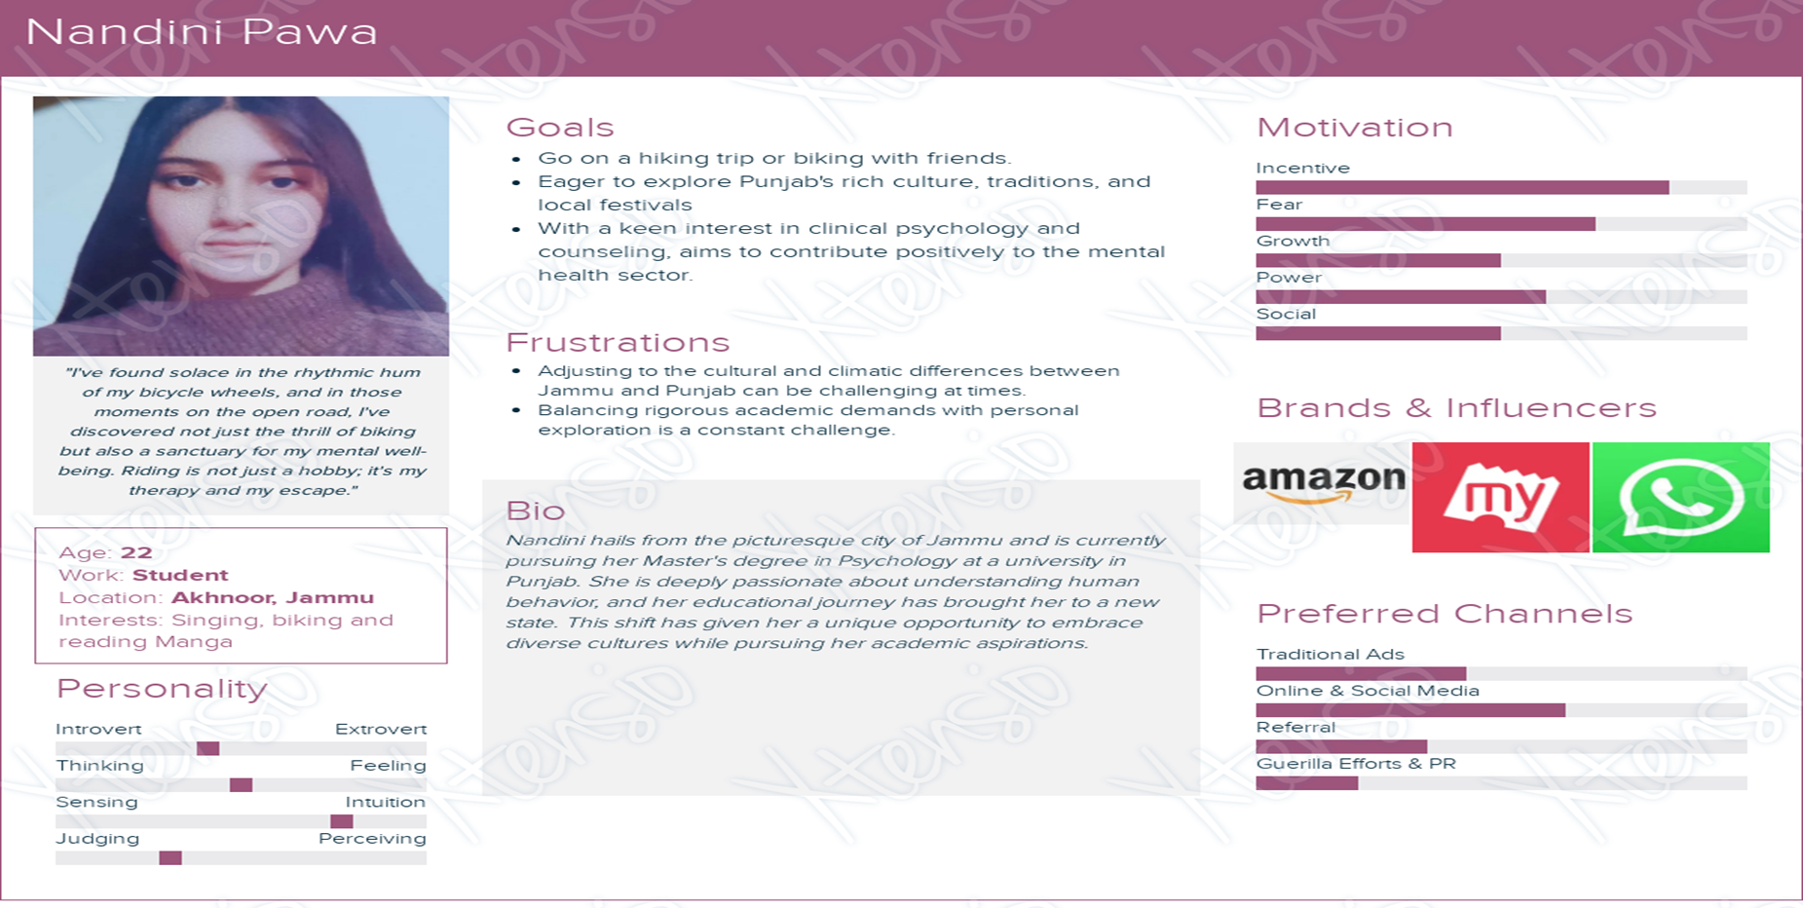
User Persona

Slide 9
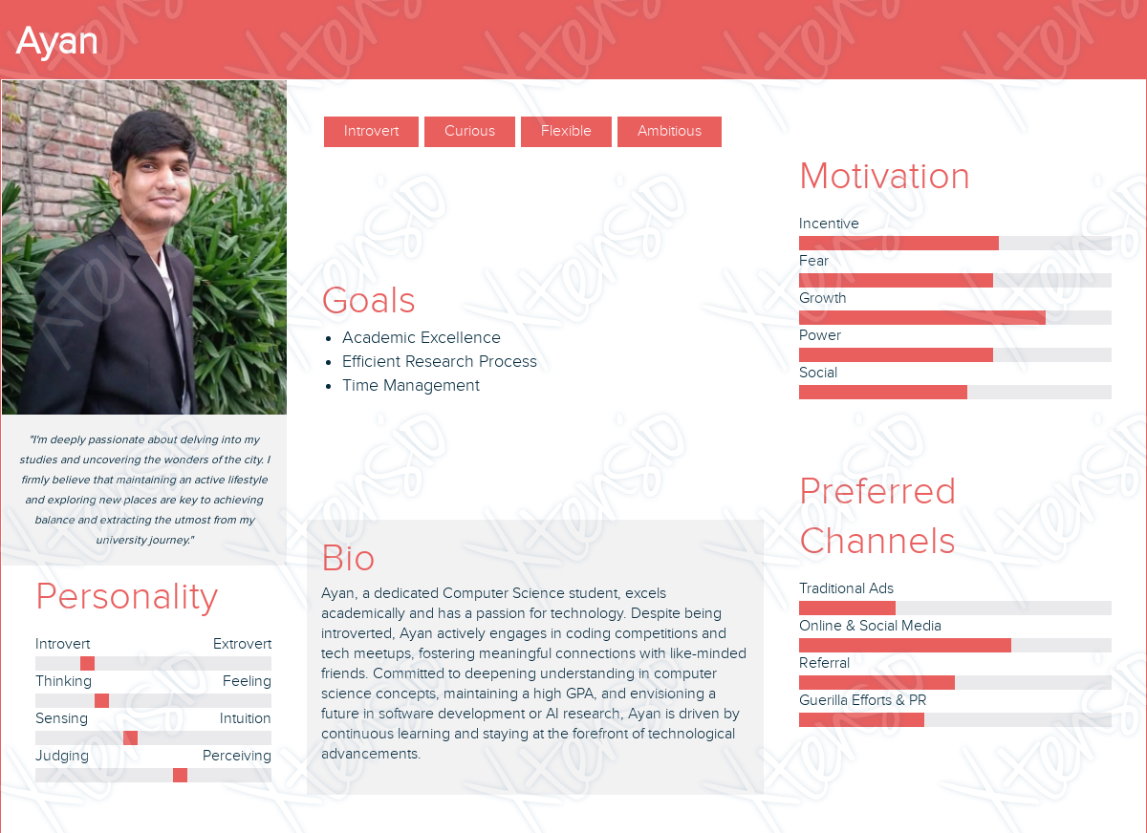
User Persona

Slide 10
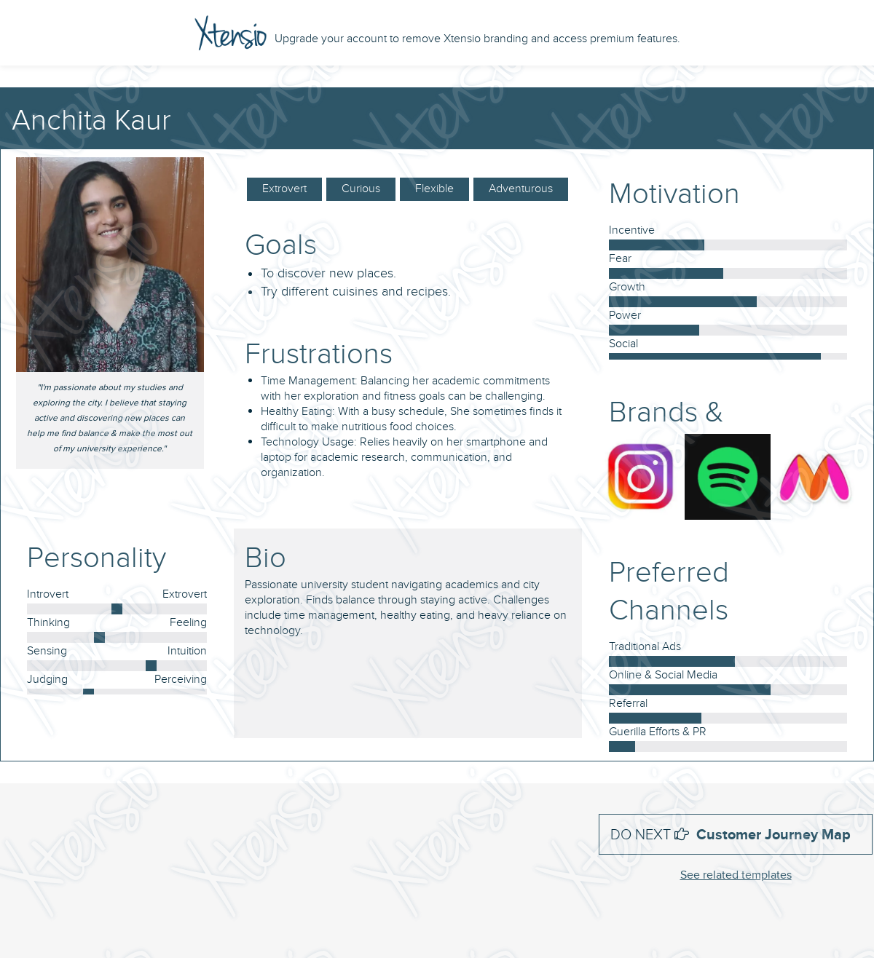
User Persona

Slide 11
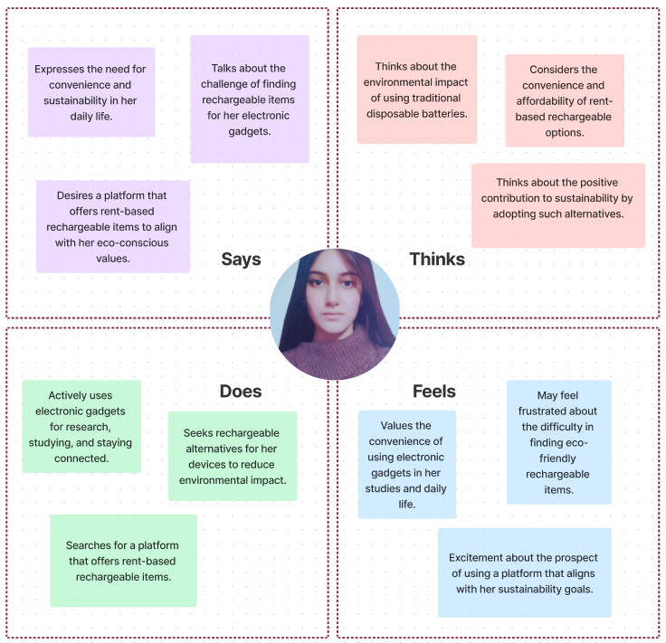
Empathy-mapping

Slide 12
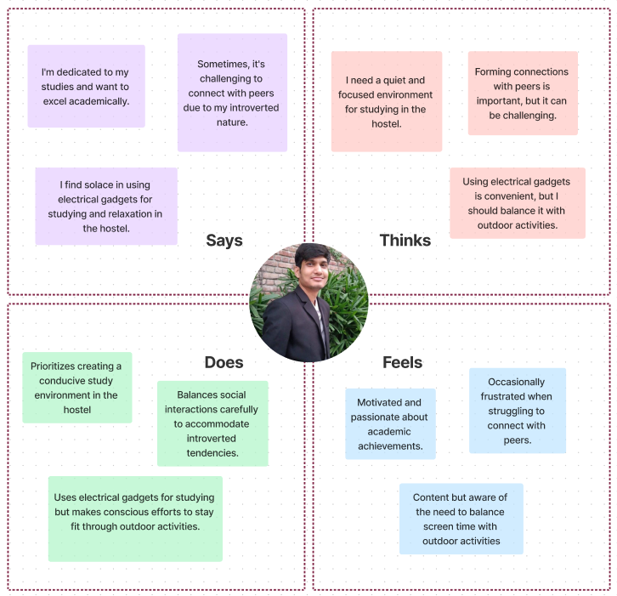
Empathy-mapping

Slide 13
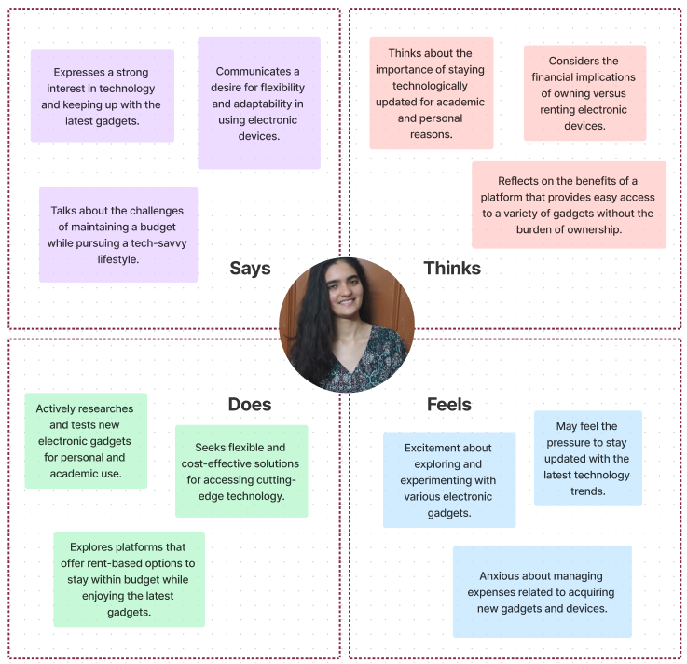
Empathy-mapping

Slide 14
Insights and Inferences
Positive Insights:
Addressing University Rules- The project addresses a significant issue by providing a solution that aligns with university rules on electrical appliances. This can create a positive impact on student life and compliance with campus regulations.
Environmental Impact- The focus on rechargeable appliances emphasizes sustainability and reduces the environmental footprint. This aligns with the growing awareness of eco-friendly practices among students and institutions.
Cost Savings- Offering a cost-effective rental service can alleviate financial constraints for students. This aspect is particularly beneficial, considering the budget limitations often faced by university students.
Diverse Appliance Options- Providing a variety of rechargeable appliances caters to the diverse needs and preferences of students, enhancing the overall satisfaction and usability of the platform.
Convenience- The convenience of a rental platform, including delivery and pickup services, simplifies the process for students, making it easier for them to access essential electrical appliances without the hassle of transportation or storage

Slide 15
Insights and Inferences
Areas for Improvement:
User Awareness- There is a need to create awareness among students about the project, its benefits, and how it aligns with university rules. A comprehensive communication strategy should be implemented to ensure widespread adoption.
Efficient Delivery and Pickup- Ensuring the efficiency of delivery and pickup services is crucial. Any delays or inconveniences in this aspect could negatively impact the user experience.
Maintenance and Quality Assurance- Establishing a robust maintenance system and quality assurance measures is essential. Students should have confidence in the functionality and safety of the rented appliances to avoid disruptions and safety concerns.
Collaboration with Universities- Strengthening partnerships and collaboration with universities is vital for the success of the project. Building a positive relationship with university administrations can facilitate smoother implementation and acceptance.
User Feedback and Iterative Improvement- Regularly collecting user feedback and implementing iterative improvements is critical. This ensures that the platform evolves based on the changing needs and preferences of the student community.
Legal and Compliance Considerations- Ensuring that the platform complies with all legal regulations and university policies is essential. Regular audits and updates to adhere to any changes in rules are crucial for the sustained success of the project.

Slide 16
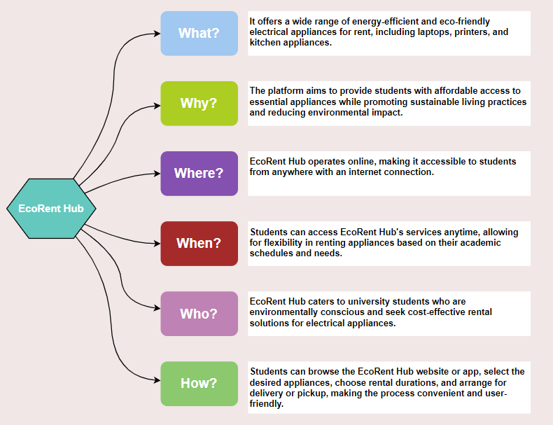
5W’s And 1H

Slide 17
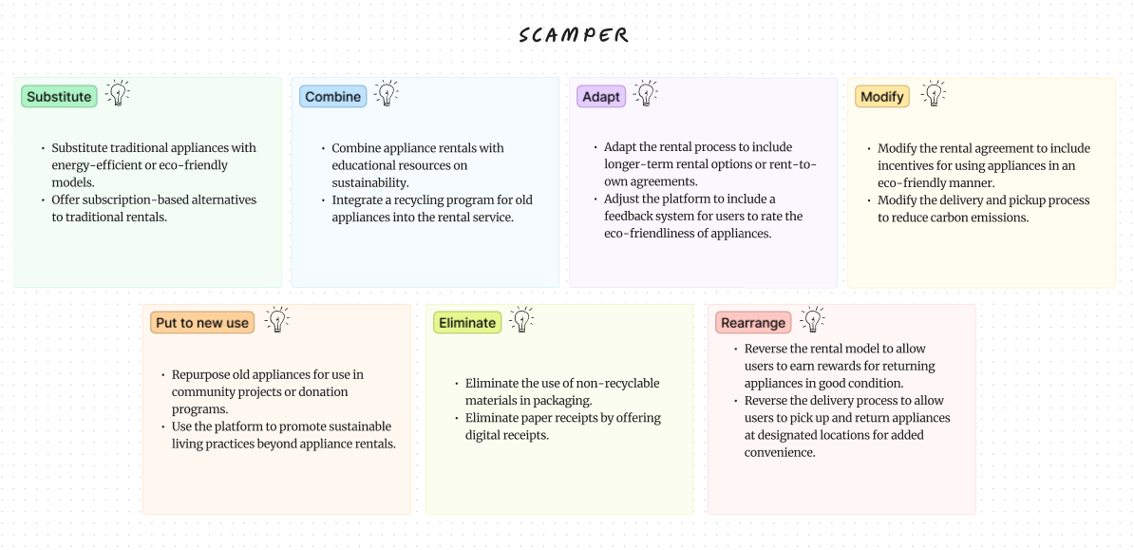
SCAMPER

Slide 18
Scenario Building
Scenario 1: The Winter Essentials
Scenario:
As winter approaches, many students in the hostel are looking for ways to stay warm and comfortable. EcoRent Hub introduces a special "Winter Essentials" rental package, including electric kettles, heating pads, heaters, and induction cooktops. Students can easily rent these appliances online to make their winter months more comfortable.
Flow:
EcoRent Hub launches the "Winter Essentials" rental package on its website.
Students visit the website and browse the available appliances, focusing on electric kettles, heating pads, heaters, induction cooktops, etc.
Students select the appliances they need and choose the rental duration.
They opt for delivery to their hostel rooms and provide the necessary details.
EcoRent Hub processes the orders and delivers the appliances to the students.
Students use the appliances throughout the winter months, staying warm and comfortable.
At the end of the rental period, students return the appliances to EcoRent Hub.

Slide 19
Scenario 2: Eco-Friendly Cooking
Scenario:
With a growing interest in sustainable living, many students are looking for eco-friendly alternatives for cooking in their hostel rooms. EcoRent Hub introduces a range of energy-efficient induction cooktops for rent, along with other kitchen essentials. Students can easily rent these appliances online and enjoy eco-friendly cooking options.
Flow:
EcoRent Hub adds energy-efficient induction cooktops to its rental offerings.
Students visit the website and explore the eco-friendly cooking options.
They select the induction cooktop and other kitchen essentials they need.
Students choose the rental duration and opt for delivery.
EcoRent Hub delivers the appliances to the students' hostel rooms.
Students use the induction cooktops for eco-friendly cooking throughout the rental period.
At the end of the rental period, students return the appliances to EcoRent Hub.

Slide 20
Scenario 3: Study and Relaxation
Scenario:
As students juggle academics and personal life, they are looking for ways to make their hostel rooms more comfortable and conducive to studying. EcoRent Hub introduces a range of appliances, including electric kettles, heating pads, and heaters, to help students create a cozy and productive environment. Students can easily rent these appliances online and enhance their hostel living experience.
Flow:
EcoRent Hub launches a new range of appliances for study and relaxation.
Students visit the website and explore the available appliances.
They select the electric kettles, heating pads, and heaters they need.
Students choose the rental duration and opt for delivery.
EcoRent Hub delivers the appliances to the students' hostel rooms.
Students use the appliances to create a cozy and productive environment for studying.
At the end of the rental period, students return the appliances to EcoRent Hub.

Slide 21
Final Idea
EcoRent Hub is a platform that offers a range of eco-friendly and energy-efficient appliances for rent to university students living in hostels. The platform aims to promote sustainable living practices by providing easy access to appliances that reduce energy consumption and environmental impact.
Key Features:
Wide Range of Eco-Friendly Appliances: EcoRent Hub offers a variety of appliances, including electric kettles, heating pads, mini refrigerators, heaters, and induction cooktops, all designed to be energy-efficient and eco-friendly.
Flexible Rental Plans: Students can choose from flexible rental plans based on their needs and budget, with options for short-term and long-term rentals.
Convenient Online Rental Process: The platform features an easy-to-use website and app where students can browse, select, and rent appliances with just a few clicks.
Delivery and Pickup Services: EcoRent Hub provides delivery and pickup services, making it convenient for students to receive and return appliances without any hassle.
Promotion of Sustainable Living: Through educational resources and partnerships with sustainability organizations, EcoRent Hub promotes sustainable living practices among students.

Slide 22
Benefits:
Cost-Effective: Renting appliances is more cost-effective than buying, especially for short-term needs.
Environmental Impact: By using energy-efficient appliances, students can reduce their carbon footprint and contribute to environmental conservation.
Convenience: EcoRent Hub offers a convenient solution for students who need appliances but don't want the hassle of buying and storing them.
EcoRent Hub aims to make sustainable living easy and accessible for university students, helping them reduce waste and live more responsibly.

Slide 23
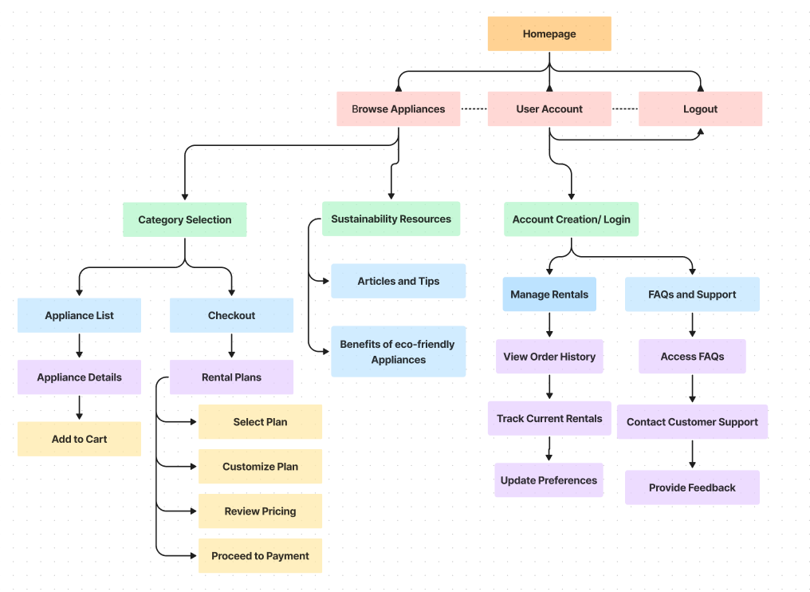
Information Architecture

Slide 24
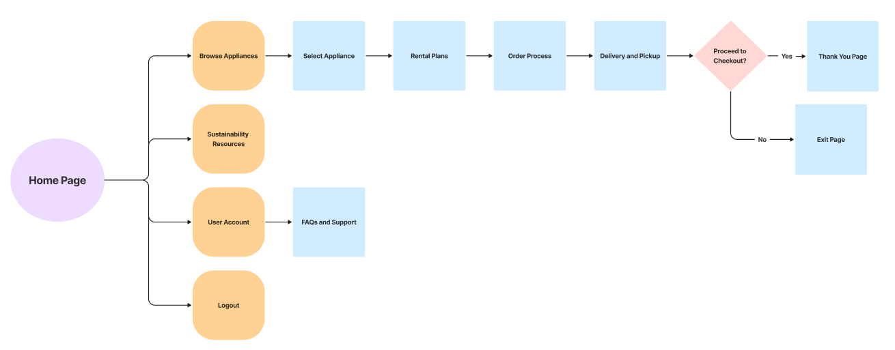
User Flow

Slide 25
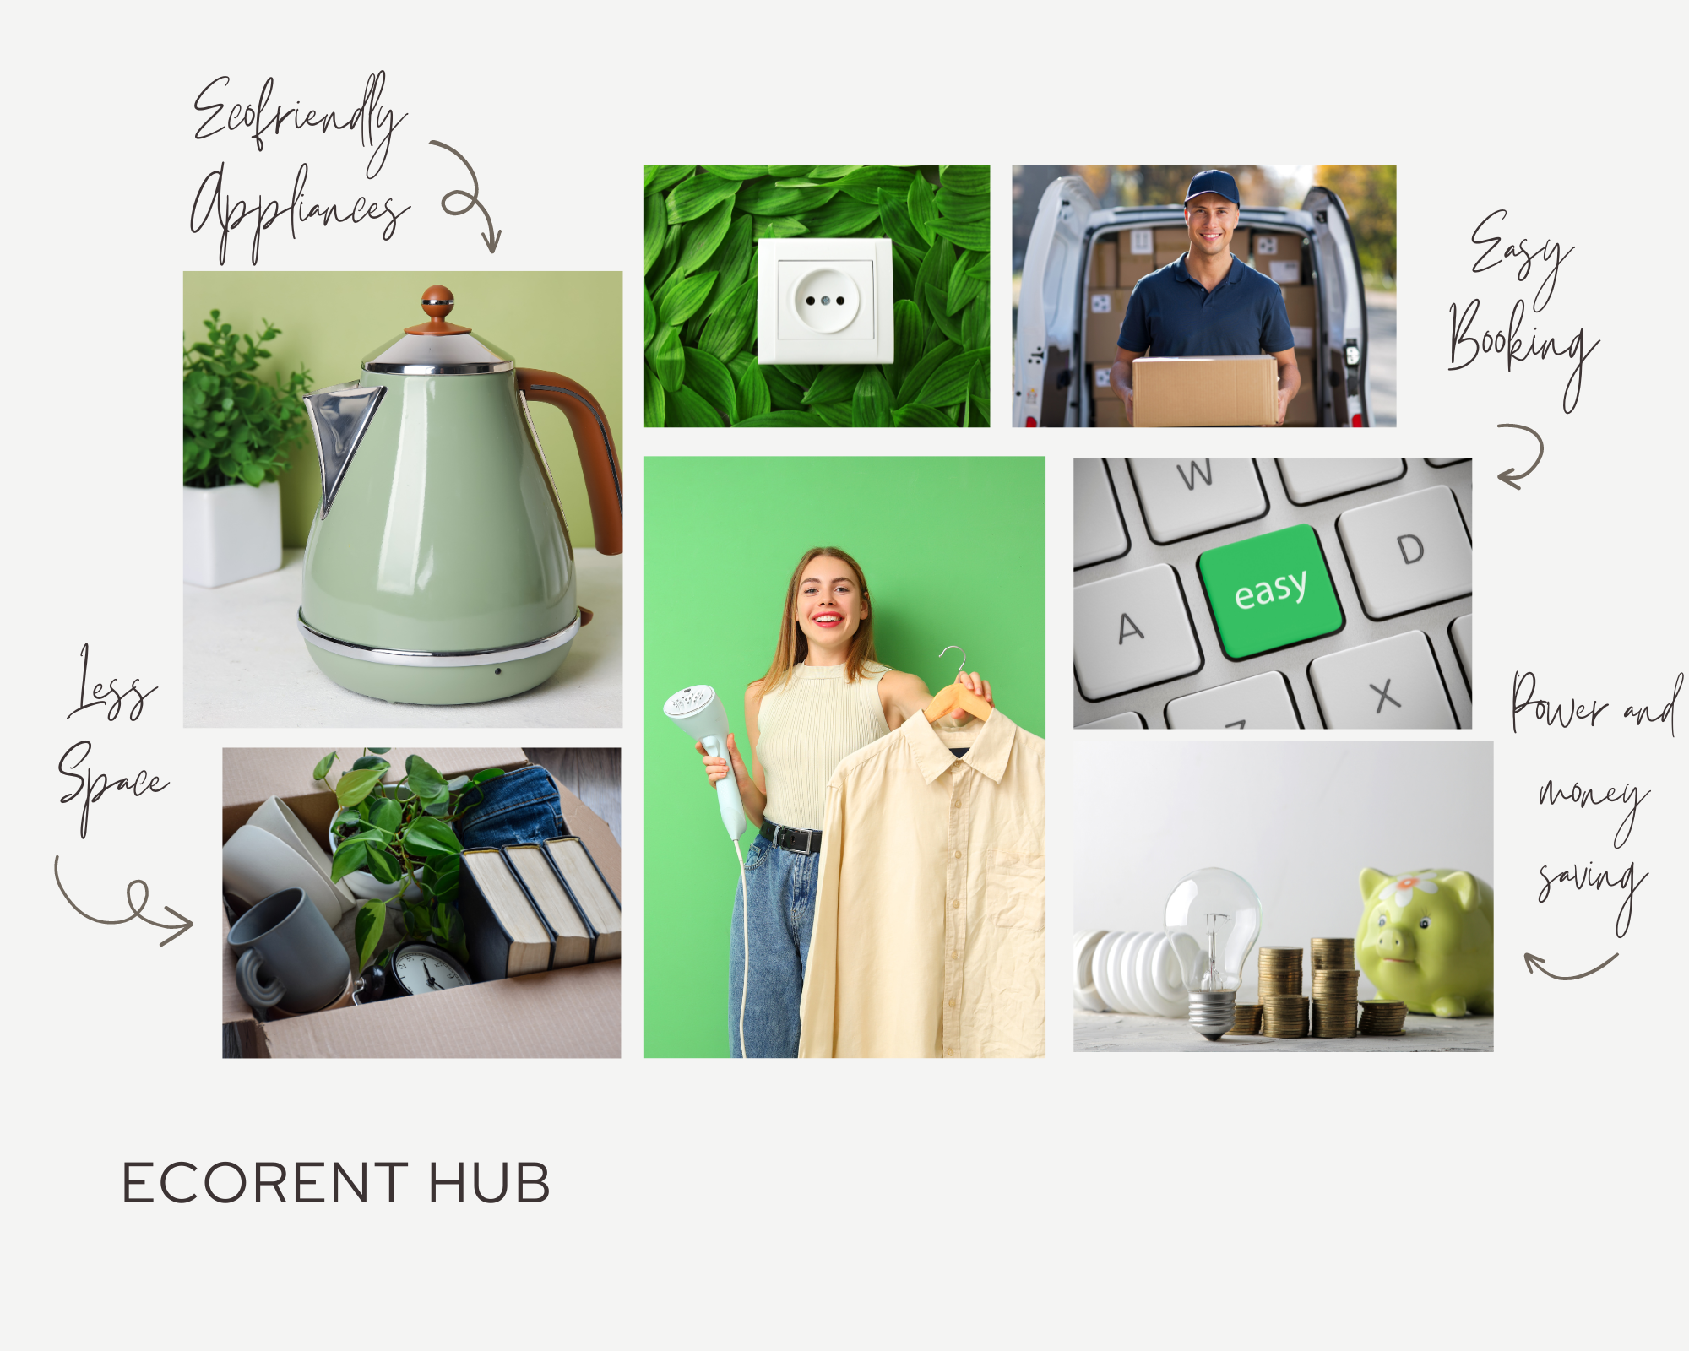
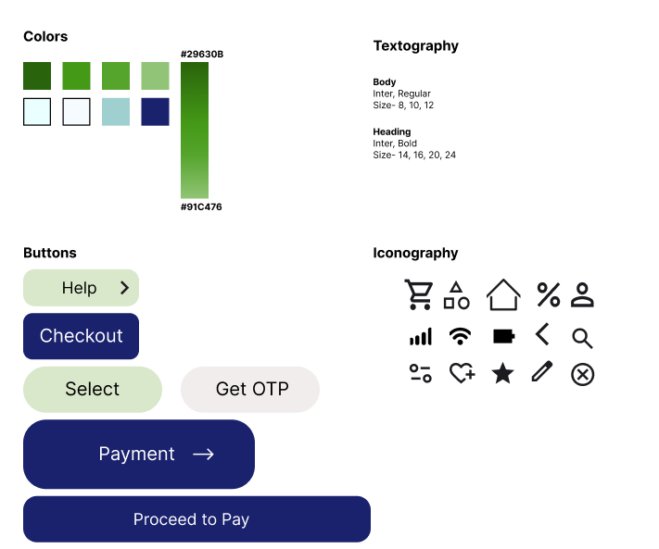
Mood Board & Style Guide

Slide 26
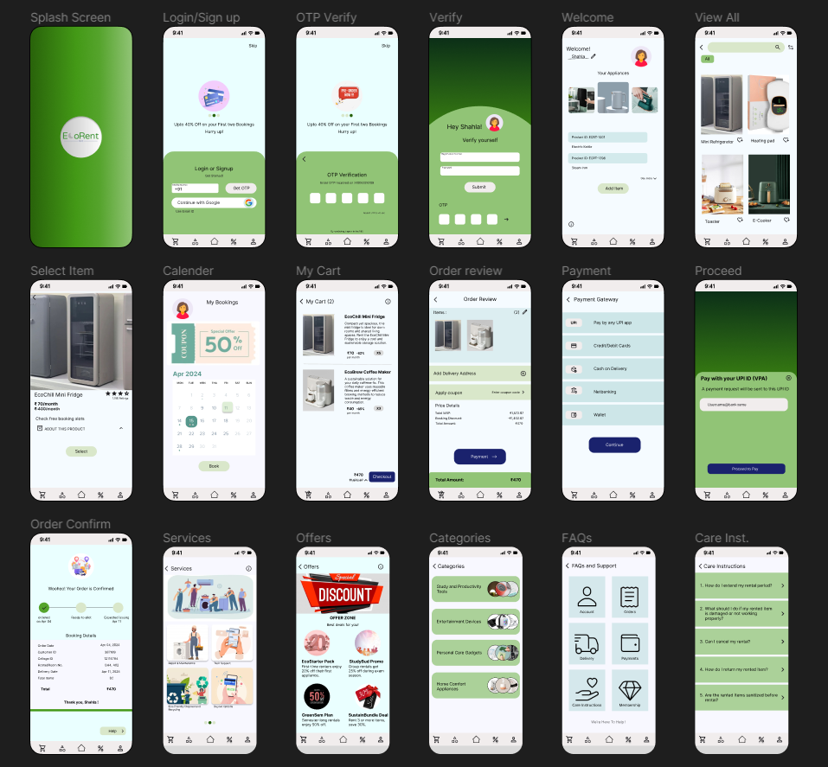
Final UI

Slide 27
Figma Link
https://www.figma.com/file/sEykGApnsaL329fJI79shC/Untitled?type=design&node-id=0%3A1&mode=design&t=d9egPWHdNRe2ecis-1

Slide 28
Thank you
Shahla Gufran

